Slide 1
Sustainability indicators for Small and Medium-sized Enterprises (SMEs) in the transition to provide Product-Service Systems (PSS)
Presentation at IPS2-15, St.Etienne, France
Erik Sundin¹, Elin Nässlander¹ and Alan Lelah²
¹Dept of Management and Engineering
Linköping University
Sweden
²G-SCOP
University Grenoble Alpes,
France

Slide 2

Erik Sundin, Associate Professor
Department of Management and Engineering
Division of Manufacturing Engineering
Linköping University
Tel: 013-286601
E-mail: erik.sundin@liu.se
Research and teaching areas:
Design for remanufacturing
Product Service Systems
Product Development
Remanufacturing
EcoDesign
Design for Manufacturing
Recycling
Cleaner
Production

Slide 3
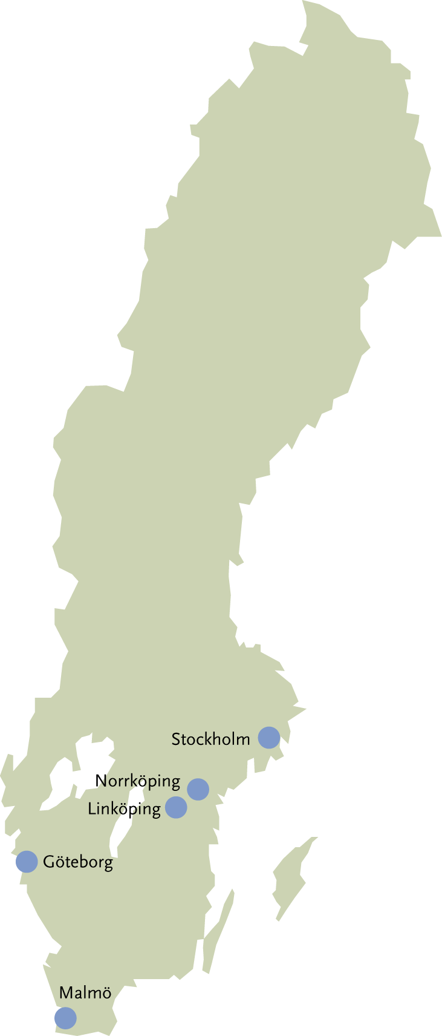
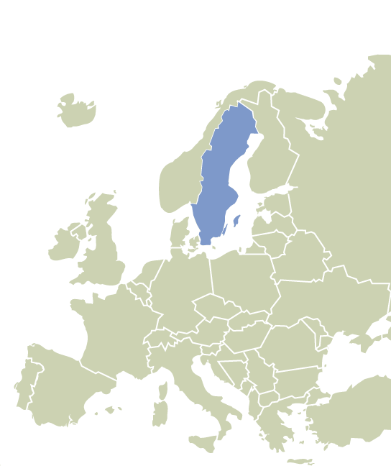

Linköping University cities
Edmonton (CAN)
Moscow and Magadan (Russia)

Slide 4
Background and objective of paper
The ServINNOV project
Scenarios for SMEs => sustainable PSS offerings
Scenario:
… “considered a synonym for an overall vision of something complex and articulated – a set of possible conditions, or transformations, affecting the domain under consideration”.
Objective of this paper:
… to determine which sustainability indicators are important for three SMEs in different phases in their development towards providing PSS.

Slide 5
Research methodology
A literature review: Ebsco Discovery Service search engine
Keywords used: “product service system AND environment”
“PSS AND environment”
“PSS AND sustainability”
“sustainability indicators”
Semi-structure interviews with 3 SMEs to:
- determine if the SMEs used any indicators,
- if they found the indicators from the literature review interesting,
- reflect on their own situation to determine the reason behind their choice of indicators.

Slide 6
Indicators
Indicator (according to OECD):
… “a parameter, or a value derived from parameters, which points to, provides information about, or describes the state of a phenomenon/environment/area, with a significance extending beyond that directly associated with a parameter value”.
Environmental sustainability indicators (according to 6 sources):
Climate change, Ozone layer depletion, Eutrophication, Acidification, Toxic contamination, Air quality, Biodiversity, Cultural landscapes, Waste generation, Water resources, Forest resources, Fish resources, Soil degradation, Material resources, Transportation, and Energy use.

Slide 7
Case companies

Slide 8
Company A (CA)
Sustainability
- increased interests
- core goal of company management
- Lucie label certified (working with ISO26000)
Indicators; many indicators developed through SYBIO;
- patronage (financial endowment, number of apprentices and trainees, optimized business sustainability profile),
- economy (treasury, result of work, investment),
- suppliers (compliance from machine manufacturer, service, diversity of supply),
- customers (customer satisfaction, recurrence, successful tenders),
- organization (attendance, skills and knowledge, flow of information), and
- products (amount of innovation in the offers, the reliability of deals, use of equipment).
Environmental sustainability indicators:
- amount of transportation
- amount of energy used

Slide 9
Company B (CB)
Sustainability
- organization, products and services
- management supported
- not well developed
Indicators
- only economic figures now
- took too long to measure and follow up
- interested in following indicators:
economic (return on each deal, amount of won tenders, amount of productivity, number of satisfied customers)
environmental (quality of the product, amount of transportation, lifetime of the products)
social (number of satisfied employees).

Slide 10
Company C (CC)
Sustainability
- personal interest
- low impact product
Indicators
- not regularly measured and followed up
- more used as checklists for ecodesign
raw material (type of material), manufacturing (components and parts manufactured externally), use (functionality, durability, user habits, assistant material, circumstances of use, waste and emissions, maintenance, repair), and end-of-life (disassembly, refurbishment and reuse, recycling, elimination).
Wished indicators to regularly measure
economic (number of satisfied customers, design aspects of the product, number of positive contracts from customer meetings), environmental (amount of water used, amount of energy used, amount of transportation, amount of materials used, amount of recycled materials used, amount of products being recycled after end-of-life, amount of recuperation of waste), and social (amount of local production, amount of local employment, health (amount of legionella bacteria)

Slide 11
Environmental sustainable indicators

Slide 12
Discussion and conclusion
Reasons to why companies work with PSS
- Economic motivation to meet customer demand
- A strong belief in PSS helping the company to become more sustainable
Sustainability work and progress awareness depends on company size, maturity and personal interests
Develop PSS offering and indicators in cooperation with current and future customers as the customer relationship is a key factor for success.
Sustainable indicators needs to be adjusted to company’s need
Focus on few indicators which makes it easy to measure and follow up

Slide 13

Thank you for your attention!
www.liu.se

